Slide 1

Image Processing and Automated Diagnosis of Multiple Sclerosis in Brain MRI using U-Net
Project Members: (Batch 13)
GOKULSIVARAJ – RA2211004010574
IBRAHIM MOHAMED S – RA2211004010585
HARAVINDA KRISHNA – RA2211004010600
Project Guide: Dr. KALIMUTHU K

Slide 2
Introduction
Multiple Sclerosis (MS) is a chronic neurological disorder affecting the central nervous system, often diagnosed through brain MRI scans. This research focuses on developing an automated system for detecting MS patterns using image processing techniques and deep learning. U-Net are employed for feature extraction and classification and Model Training. The proposed approach aims to improve early and accurate diagnosis, reducing reliance on manual interpretation and enhancing clinical decision-making. Experimental results demonstrate the model’s high accuracy in identifying MS lesions.

Slide 3
Motivation & Objectives of the Work
Motivation:
Multiple Sclerosis (MS) is a chronic neurological disorder that requires early and accurate diagnosis to improve patient outcomes. Automating the detection of MS lesions in MRI scans using U-Net can enhance diagnostic efficiency, reducing human error and processing time.
Objective:
To develop an automated system using U-Net and Image Processing for detecting and segmenting MS lesions in brain MRI scans, improving accuracy and aiding neurologists in early diagnosis.

Slide 4
Literature Review
S.No | Title | Author(s) and Journal | Year | Methodology | Disadvantages
1 | Brain Tumour Segment of MRI Images Using Processed Image Driven U-Net Architecture | Anuja Arora, Ambikesh Jayal, Mayank Gupta, Prakhar Mittal, and Suresh Chandra Satapathy, Computers journal | 2021 | Utilizes deep learning models, primarily encoder-decoder CNNs (like U-Net), for lesion segmentation from MRI. Emphasis on fully automated pipelines using 2D/3D convolutions, data augmentation, and cross-validation. | High dependency on large annotated datasets. Domain shifts (scanner variation) reduce generalizability. Lesion heterogeneity and small lesion size make segmentation challenging.
2 | Misdiagnosis of Multiple Sclerosis | Andrew J. Solomon, Robert T.Naismith, Anne H.Cross Neurology American Academy of Neurology | 2019 | Combines algebraic multigrid segmentation with region-based feature extraction. Features are classified using decision forests for lesion segmentation and classification. | Relies on handcrafted features, which may limit performance in diverse datasets. Classifier accuracy is sensitive to MRI noise and artifacts. Potential scalability issues with high-resolution or large volumes of data.

Slide 5
3 | Multiple Sclerosis Lesion Analysis in Brain Magnetic Resonance Images: Techniques and Clinical Applications | Ma, Yang, Chaoyi Zhang, Mariano Cabezas, Yang Song, Zihao Tang, Dongnan Liu, Weidong Cai, Michael Barnett, and Chenyu Wang. IEEE | 2022 | Focuses on deep learning approaches (mainly CNNs like U-Net) for MS lesion segmentation using MRI. Discusses the use of encoder-decoder architectures for accurate lesion localization and delineation. | Requires large annotated datasets which are scarce. Performance suffers due to lesion heterogeneity and variability across scanners and protocols (domain shift). High computational cost and limited clinical validation.
4 | Automatic segmentation and classification of multiple sclerosis in multichannel MRI | Akselrod-Ballin, Ayelet, Meirav Galun, John Moshe Gomori, Massimo Filippi, Paola Valsasina, Ronen Basri, and Achi Brandt IEEE | 2009 | Combines multiscale algebraic multigrid-based segmentation with decision forest classifiers. Utilizes regional features from 3D multichannel MRI for both segmentation and classification. | Heavily dependent on handcrafted features, which may limit generalization. Classifier performance can degrade with noisy or low-contrast images. May not scale well to large datasets or diverse clinical conditions.

Slide 6
5 | MRI in the Diagnosis and Monitoring of Multiple Sclerosis: An Update | M.P. Wattjes, M.D. Steenwijk, M.Stangel Clinical Neuroradiology(Peer-reviewed medical journal) | 2015 | Applies Gaussian Mixture Models (GMMs) for tissue classification and lesion expansion. Integrates brain atlas-based preprocessing and segmentation refinement steps. | Accuracy depends on quality of initial GMM modeling. Vulnerable to false positives due to noise or motion artifacts. May require manual intervention for validation or correction.

Slide 7
Problem Statement
Multiple Sclerosis (MS) is a neurological disorder that leads to brain and spinal cord damage, requiring early and precise diagnosis.
Traditional MS detection through MRI analysis is time-consuming, prone to human error, and requires expert radiologists
.
This project aims to develop an automated system using U-Net and Image Processing to enhance the accuracy and efficiency of MS lesion detection in brain MRI scans.

Slide 8
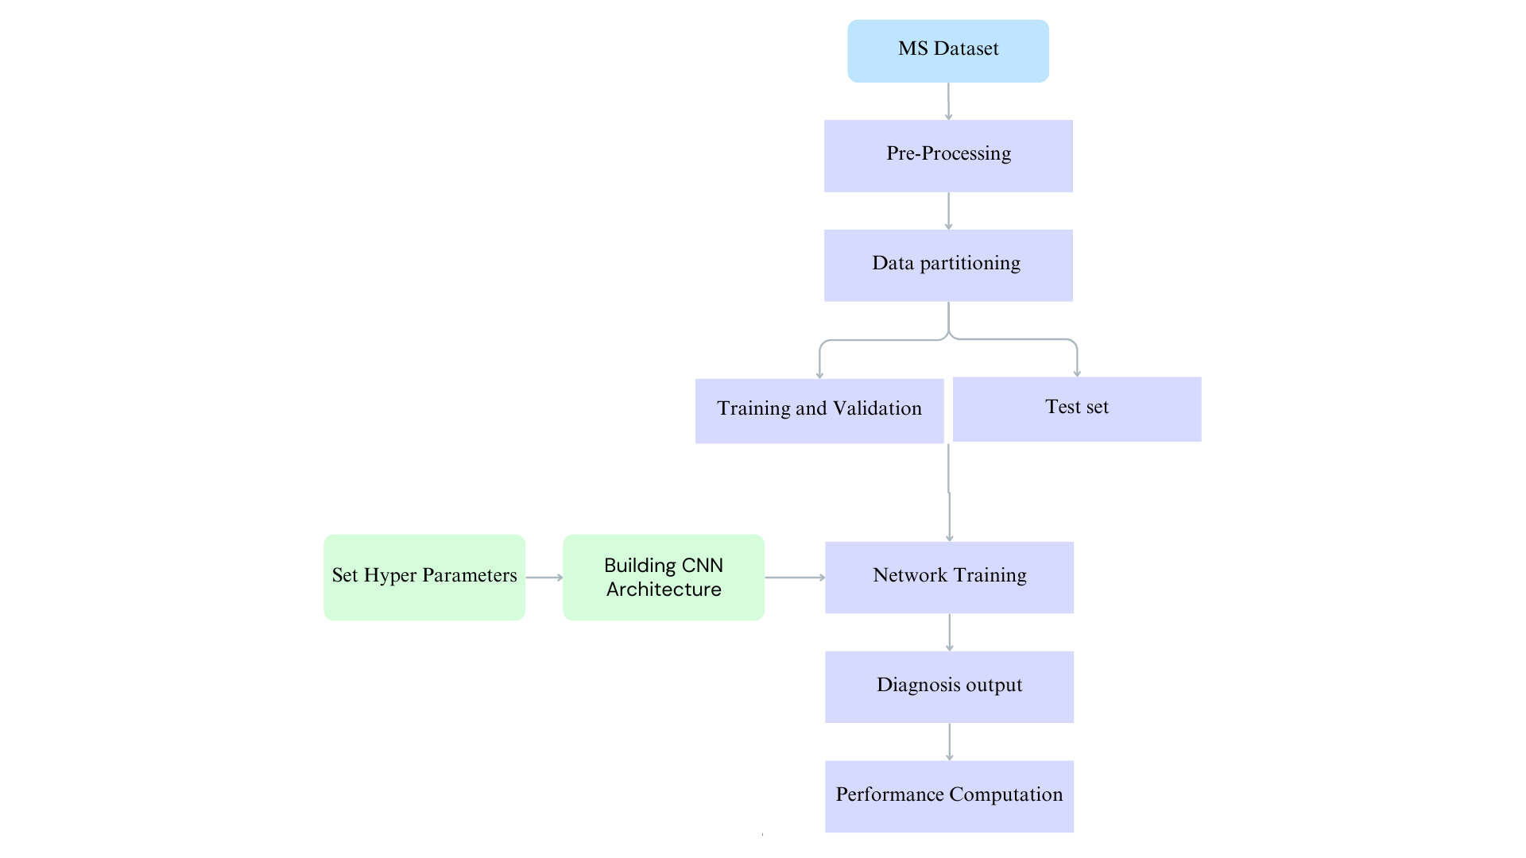
Block Diagram
MS Dataset The process begins with acquiring a brain MRI dataset with annotated MS lesions, including FLAIR, T1, and T2 modalities.
Pre-Processing MRI scans undergo essential pre-processing steps such as skull stripping, bias field correction, intensity normalization, and co-registration of modalities.
Data Partitioning The dataset is split into training, validation, and test sets to ensure robust evaluation and generalization.
Training and Validation / Test Set The training and validation set is used for learning and tuning the model.
The test set is reserved for final evaluation.
Set Hyperparameters Key hyperparameters like learning rate, batch size, and number of epochs are defined.
Building CNN Architecture A 2D/3D U-Net architecture is constructed, featuring an encoder-decoder structure with skip connections to capture both contextual and spatial information.
Network Training The U-Net model is trained using annotated MS lesion masks. Loss functions like Dice Loss or Cross-Entropy are employed to optimize segmentation accuracy.
Diagnosis Output The trained model outputs segmented MS lesions, enabling lesion detection and localization.
Performance Computation Model performance is evaluated using metrics such as Dice Coefficient, Sensitivity, Specificity, and Hausdorff Distance.

Slide 9
Engineering Standards
1. Data Standards
Image Format: Use high-quality JPEGs (≥95%).
Dataset Structure:
/train/: T1, T2, FLAIR images, and lesion masks.
Consistent image size (e.g., 256×256 px).
2. Model Architecture
U-Net: Follow the 2015 original paper for segmentation.
Reproducibility:
Set random seeds.
Track dependencies (requirements.txt).
3. Preprocessing
Normalization: Scale pixel values to [0, 1] or z-score.
Resize images with bicubic interpolation.

Slide 10
Engineering Standards
4. Evaluation Metrics
Segmentation Metrics:
Dice Similarity Coefficient (DSC)
Intersection over Union (IoU)
Sensitivity / Recall
Cross-validation (5-fold).
5. Software & Deployment
Follow PEP8 coding standards.
Docker for reproducibility (base image: python:3.10).
6. Ethics & Documentation
Data Anonymization for patient privacy.
Comply with HIPAA or GDPR.
Document all steps: data collection to evaluation.

Slide 11
Realistic Constraints
Data Availability & Quality:
Limited access to labeled MRI datasets due to patient privacy concerns. Variability in MRI scan quality (noise, intensity differences, artifacts).
Computational Resources:
Deep learning models require high-end GPUs/TPUs for training, which may not be easily accessible. Trade-off between model complexity and inference speed for real-time diagnosis.
Regulatory & Ethical Considerations:
Must meet FDA/CE approval for clinical deployment. Ethical concerns about AI replacing human radiologists rather than assisting them.
Generalization & Model Robustness:
Ensuring the model works across different MRI machines and imaging protocols. Avoiding bias in training data to prevent misdiagnosis in underrepresented patient groups.
User Adoption & Integration:
The AI system should seamlessly integrate with existing hospital PACS (Picture Archiving and Communication System). Requires an interpretable model to gain acceptance from medical professionals.

Slide 12
Tools Used
Python: The core programming language.
TensorFlow & Keras: For building and training the MS detection model.
NiBabel: Reads MRI (.nii) files.
Pandas & NumPy: For organizing and processing data.
Matplotlib & Seaborn: For data visualization.
Zipfile: For handling the dataset's zip format.
Scikit-learn: For data splitting and evaluation.
Dataset Used: Used Mendeley dataset for multiple sclerosis in mri image in nii. format and converted to jpeg format and invivo (n=455) for general mri images.
Google Colab: The free platform for running and accelerating the code (with GPUs).

Slide 13
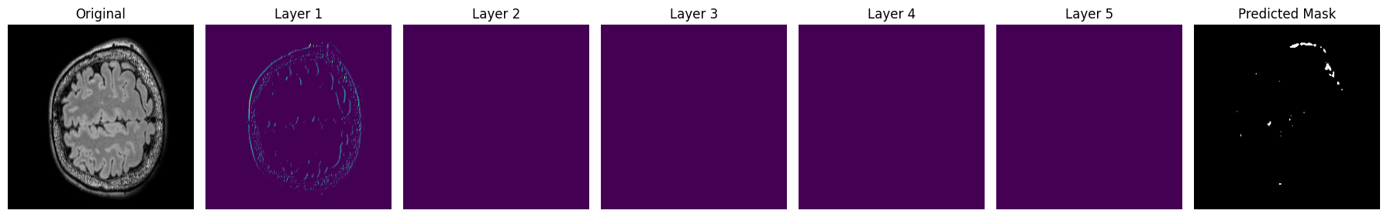
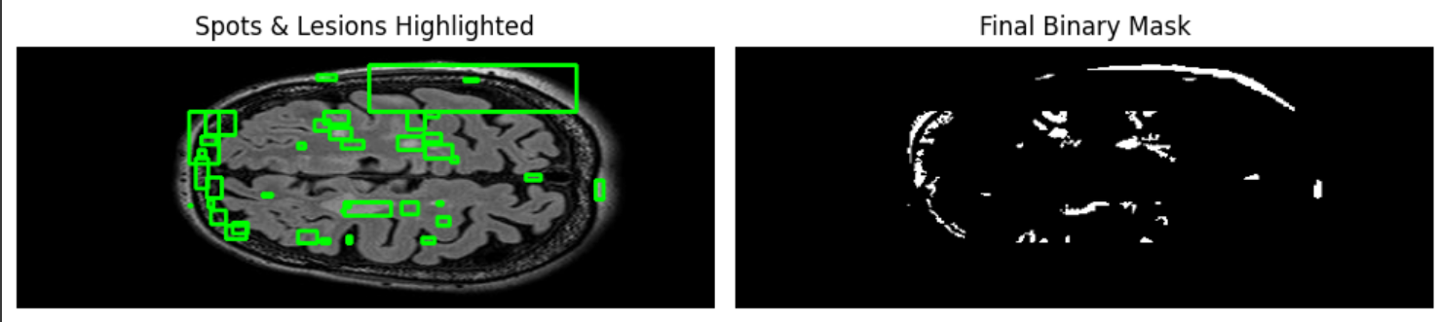
Results

Slide 14
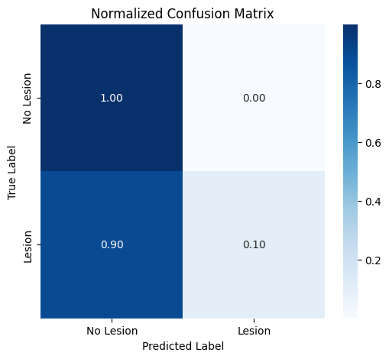
Evaluation

Slide 15
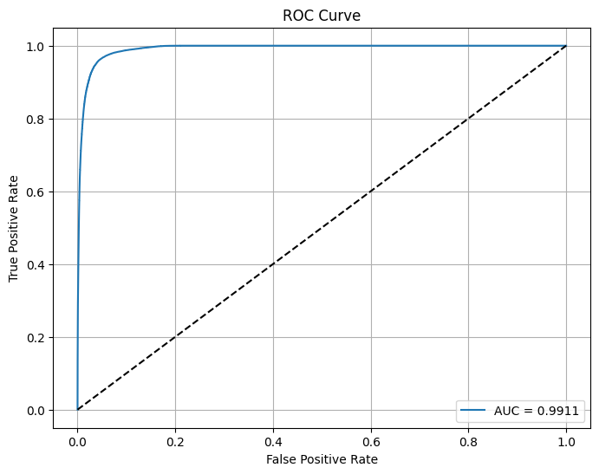
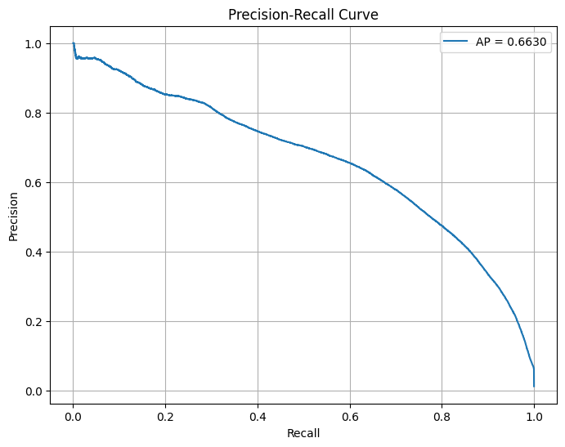

Slide 16
Conclusion
An effective deep learning-based approach has been developed for the automated diagnosis of MS using FLAIR brain MRI images. Utilizing a U-Net, the system accurately detects and segments MS lesions, significantly reducing the need for manual interpretation. The image preprocessing steps—including skull stripping, bias field correction, denoising, and normalization—played a vital role in enhancing lesion visibility and enabling the model to extract meaningful features.
The predicted lesion masks demonstrated strong agreement with ground truth data, and performance evaluation through the confusion matrix and ROC analysis confirmed the reliability and accuracy of the system. The exclusive use of FLAIR images simplified the process while maintaining high diagnostic sensitivity. This methodology offers a reliable and efficient solution to support radiologists in early MS detection and diagnosis. Further improvements can be achieved by expanding the dataset and integrating multi-modal imaging for enhanced generalization and lesion characterization.

Slide 17
References
Wattjes, M. P., M. D. Steenwijk, and M. Stangel. "MRI in the diagnosis and monitoring of multiple sclerosis: an update." Clinical neuroradiology 25 (2015): 157-165.
Arora, Anuja, Ambikesh Jayal, Mayank Gupta, Prakhar Mittal, and Suresh Chandra Satapathy. "Brain tumor segmentation of mri images using processed image driven u-net architecture." Computers 10, no. 11 (2021): 139.
Solomon, Andrew J., Robert T. Naismith, and Anne H. Cross. "Misdiagnosis of multiple sclerosis: Impact of the 2017 McDonald criteria on clinical practice." Neurology 92, no. 1 (2019): 26-33.
Westmoreland, Shaylyn. Development of an AI-Based Platform for Early Diagnosis of Multiple Sclerosis. Widener University, 2024.
Liu, Jin, Yi Pan, Min Li, Ziyue Chen, Lu Tang, Chengqian Lu, and Jianxin Wang. "Applications of deep learning to MRI images: A survey." Big Data Mining and Analytics 1, no. 1 (2018): 1-18.
Dipu, Nadim Mahmud, Sifatul Alam Shohan, and KM A. Salam. "Brain tumor detection using various deep learning algorithms." In 2021 International Conference on Science & Contemporary Technologies (ICSCT), pp. 1-6. IEEE, 2021.

